Slide 1



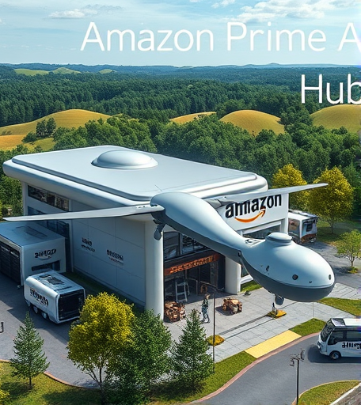
DRONE HUB LOCATION FOR THE PRIME AIR PROGRAM
AMAZON PRIME AIR: STRATEGIC DRONE DEPLOYMENT PLAN FOR MASSACHUSETTS
PRESENTED BY:
RAHUL MISHRA
BEN LUONG
SRUTI NARASIMHAN
LEAH JACOBSON

Slide 2

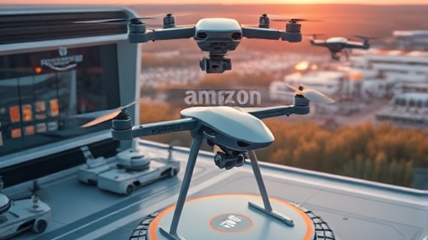
CONTENTS
Title
Executive Summary
Online Business Trends
Population & Demographics
Location Plan & Deployment
Drone Technology Overview
Challenges and Risks
Conclusion

Slide 3
EXECUTIVE SUMMARY
Deploy drone hubs in Massachusetts
Global e-commerce growth
MK30 drones
Ideal market for initial adoption
Launch phased hubs in high-potential areas
Notes:
Our Strategic Objective is to Deploy drone hubs in Massachusetts to maximize delivery efficiency, customer satisfaction, and scalability for Amazon Prime Air. Global e-commerce growth drives demand for faster, more flexible delivery; Amazon’s leadership position enables early advantage. MK30 drones offer enhanced speed, environmental sustainability, and compliance for last-mile delivery innovation. Our Target Demographic is Massachusetts’ affluent, tech-savvy suburban population. This provides an ideal market for initial drone delivery adoption. Our Deployment Strategy is to launch phased hubs in high-potential areas, expanding coverage methodically to support sustainable growth and operational excellence.

Slide 4

ONLINE BUSINESS TRENDS
E-commerce sales projected to hit $6.56T globally and $1.19T in the U.S. by 2025
Amazon holds 37.6% of U.S. e-commerce share
86% of its shipments are drone-suitable
Prioritize lightweight, urgent-need items
Rapid drone delivery of critical medicines
Notes:
• Global E-Commerce Surge: E-commerce sales projected to hit $6.56T globally and $1.19T in the U.S. by 2025, driving demand for faster delivery solutions. • Amazon’s Market Leadership: Amazon holds 37.6% of U.S. e-commerce share; 86% of its shipments are drone-suitable (under 5 pounds and compact). • Optimized Product Focus: Drone hubs prioritize lightweight, urgent-need items like electronics, personal care, wellness products, and emergency medicines. • Emergency Delivery Advantage: Rapid drone delivery of critical medicines enhances customer value, supports public health, and strengthens Amazon’s brand as a healthcare enabler.

Slide 5
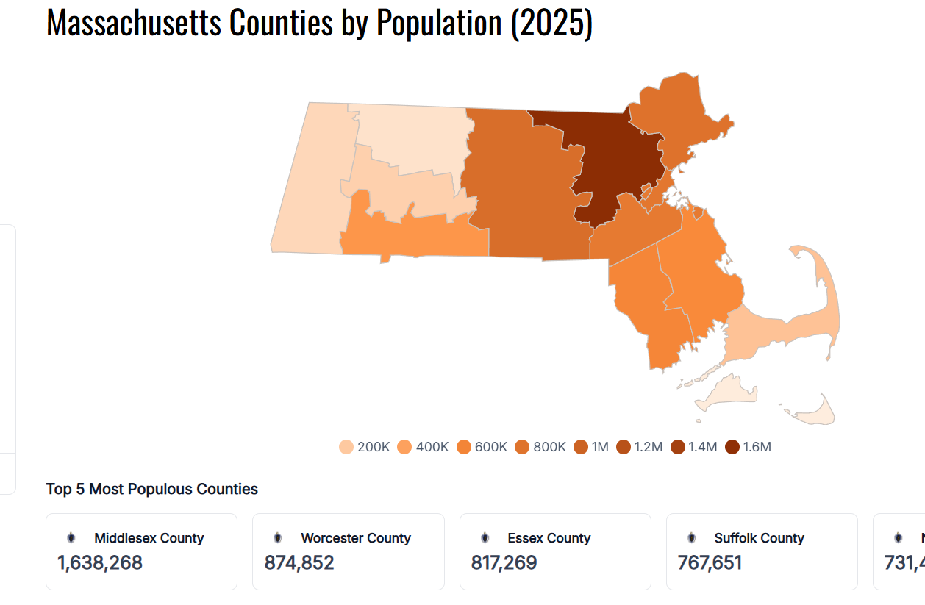
POPULATION & DEMOGRAPHICS
7.1 million residents
35% aged 20–44
17% seniors aged 65+
Target Urban Areas
3rd nationally in online shopping
Median household income: ~$95K
Notes:
As for Population Distribution, Massachusetts has 7.1 million residents with 35% aged 20–44, 17% seniors aged 65 and above.
We want to target urban areas. Our key delivery hubs are Waltham, Framingham, Quincy, Worcester, and Springfield based on demographic density.
For the online Shopping Potential, Massachusetts ranks third nationally in online shopping, with high Amazon Prime membership potential across demographics.
In massachusetts, tere is strong Economic Strength:. The median household income is approximately $95K; affluent counties like Middlesex and Norfolk offer high purchasing power and strong Prime membership adoption.

Slide 6

LOCATION PLANNING OVERVIEW
Hubs placed to maximize:
Coverage
Efficiency
Customer Satisfaction
High Income
Dense population (7 mile radius)
Airspace safety
Region | City | Justification
Western MA | Springfield, Northampton | low airspace congestion, community access
Central MA | Worcester | urban-suburban mix, growing economy
Eastern MA | Waltham, Framingham, Quincy | affluent suburbs, high Prime adoption
Notes:
We want our drone hubs placed to maximize coverage, efficiency, and customer satisfaction across Massachusetts’ suburban regions. We based our site selection criteria based on High income, dense population within 7-mile radius, suburban airspace safety, and statewide geographic balance. • Proposed Hub Cities: - Western MA: Springfield, Northampton — low airspace congestion, community access - Central MA: Worcester — urban-suburban mix, growing economy - Eastern MA: Waltham, Framingham, Quincy — affluent suburbs, high Prime adoption

Slide 7
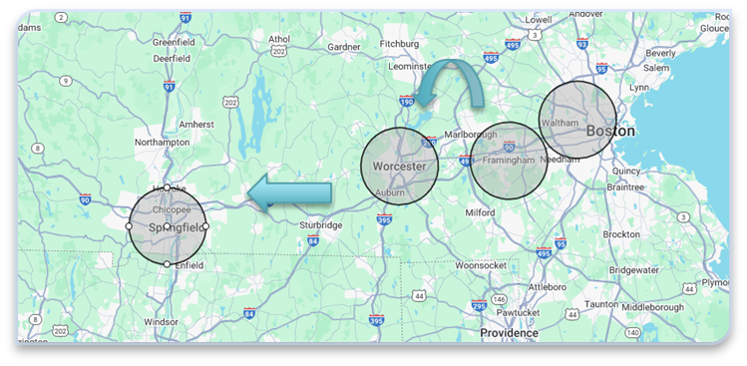
DEPLOYMENT STRATEGY AND IMPACT
Phased Rollout: - Phase 1: Waltham & Framingham - Phase 2: Worcester - Phase 3: Springfield &
Northampton
~14% state population coverage
~13,300 weekly deliveries at launch
30–40% spike during peak seasons.
Benefits:
Minimized risk
Scalable growth
Customer loyalty
Notes:
Phased Rollout: - Phase 1: Launch in Waltham & Framingham - Phase 2: Expand to Worcester - Phase 3: Expand west to Springfield & Northampton • Service Coverage: 7-mile radius enables ~14% state population coverage (~1M residents). • Delivery Volume Estimates: ~13,300 weekly deliveries at launch; projected 30–40% spike during peak seasons. • Strategic Benefits: Minimized risk, scalable growth, enhanced customer loyalty in high-value markets.

Slide 8
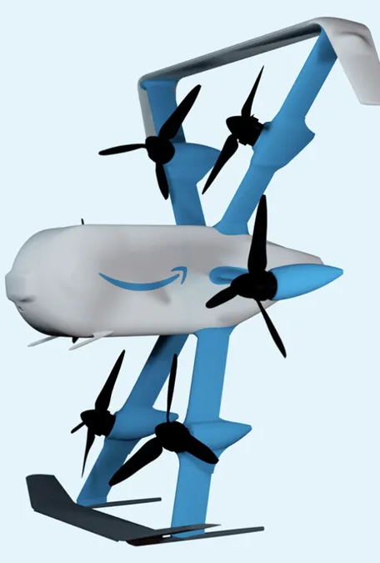
DRONE TECHNOLOGY OVERVIEW
MK30 Drone
Delivers packages under 5 pounds
Within 30 minutes
12–15 mile range
61 mph speed
Outperformance
Payload capacity
Suburban suitability
Environmental friendliness
Cost Efficiency Goals
Fall from $484 (2022) to $63 (2025)
Notes:
• MK30 Drone Capabilities: Amazon’s MK30 drone delivers packages under 5 pounds within 30 minutes, featuring 12–15 mile range, 61 mph speed, and quieter, rain-resilient operations.
• Advanced Safety Features: Equipped with redundant flight systems, obstacle avoidance (visual, radar, LIDAR), and automated return-to-base for high reliability and FAA compliance.
• Regulatory Milestones: FAA Part 135 and BVLOS certifications enable large-scale, beyond-visual-line-of-sight drone operations across suburban regions.
• Competitive Advantage: MK30 outperforms alternatives in payload capacity, suburban suitability, and environmental friendliness, producing zero direct CO₂ emissions.
• Cost Efficiency Goals: Delivery cost targeted to fall from $484 (2022) to $63 (2025) through scaling, tech upgrades, and infrastructure optimization.

Slide 9
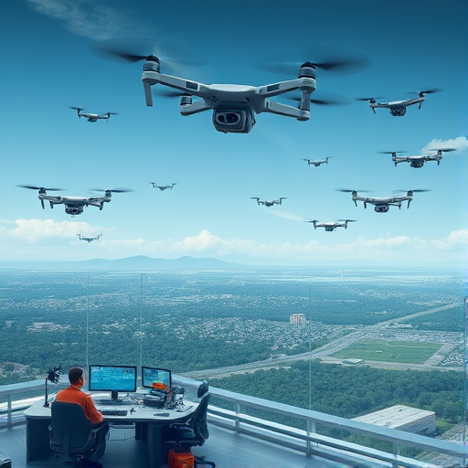
CHALLENGES AND RISKS
Regulatory Uncertainty
Public Acceptance Challenges
Operational and Competitive Pressures
Notes:
Regulatory Uncertainty: FAA and local laws impose complex, evolving constraints potentially delaying drone hub expansions and approvals.
Public Acceptance Challenges: Noise, privacy, and safety concerns necessitate proactive community engagement to secure social license for operations.
Operational and Competitive Pressures: Adverse weather affects reliability; managing dense drone traffic is complex amid intense competition from major firms.

Slide 10

CONCLUSION
Prime environment
Strong e-commerce growth
Competitive positioning in suburban and semi-urban markets.
High-income, tech-savvy suburban communities
Phased deployment covers ~14%
Notes:
• Strategic Opportunity: Massachusetts offers a prime environment for Prime Air to revolutionize last-mile logistics with faster, sustainable, and reliable drone deliveries. • Market Alignment: Strong e-commerce growth, Amazon’s product suitability, and demand for urgent, lightweight deliveries fuel operational volume. • Technology Advantage: MK30 drone’s speed, resilience, and FAA certifications secure competitive positioning in suburban and semi-urban markets. • Demographic Fit: High-income, tech-savvy suburban communities around Boston, Worcester, and Springfield provide ideal early-adoption markets. • Scalable Rollout: Phased deployment covers ~14% of the state population, with >13,000 weekly deliveries, building a strong foundation for broader expansion.

